Slide 1
Unit 3 Access Control

Slide 2
Access Control
The mechanism which defines user access is called access control.
When the server receives a request, it uses the authentication information provided by the user and the access control instructions (ACIs) to allow or deny access to directory information.
The server can allow or deny permissions for actions on entries like read, write, search, and compare.

Slide 3
Access Control Principles
Access control is not a stand alone component of a security system
Access control coexists with other security services
Access control works closely with audit control
Access matrix is a good tool to specify permissions
Access Control List (ACL) details are placed in Access Matrix

Slide 4
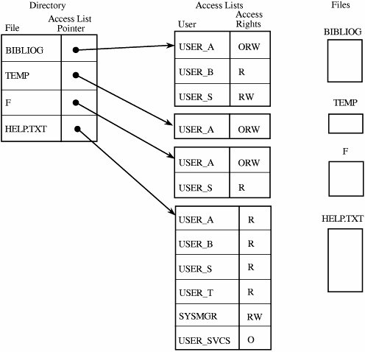
Access Control List
There is one such list for each object, and the list shows all subjects who should have access to the object and what their access is.

Slide 5
Discretionary Access Control
Discretionary Access Control (DAC) is a type of access control in which a user has complete control over all the programs it owns and executes, and also determines the permissions other users have to those files and programs.
Restricts access to objects based solely on the identity of users who are trying to access them.
Because DAC requires permissions to be assigned to those who need access, DAC is commonly described as a "need-to-know" access model.

Slide 6
Discretionary Access Control
Relies on the object owner to control access.
Strength of DAC: Flexibility
Limitations of DAC:
– Global policy: DAC lets users to decide the access control policies on their data, regardless of whether those policies are consistent with the global policies.
– Information flow: information can be copied from one object to another, so access to a copy is possible even if the owner of the original does not provide access to the original copy.
– Malicious software: DAC policies can be easily changed by owner, so a malicious program (e.g., a downloaded untrustworthy program) running by the owner can change DAC policies on behalf of the owner.

Slide 7
Mandatory Access Control
Mandatory Access Control (MAC) is a type of access control in which only the administrator manages the access controls.
The administrator defines the usage and access policy, which cannot be modified or changed by users, and the policy will indicate who has access to which programs and files.
MAC is most often used in systems where priority is placed on confidentiality.

Slide 8
Role-based Access Control
Role-based access control (RBAC) is a type of access control in which access is based on the roles of individual users within an enterprise.
Roles are defined according to job competency, authority, and responsibility within the enterprise.
A user has access to an object based on the assigned role.
The object is concerned with the user’s role and not the user.
Role of the user in the organization determines the access level for the database
Roles can define specific individuals allowed access or extent of access to resources for multiple individuals

Slide 9
Role-based Access Control
RBAC supports the following security principles:
Least privilege (only the needed permissions are assigned to roles)
Separation of duties (use of mutually exclusive roles – e.g., accountant writes cheque and manager signs the cheque)
Data Abstraction (instead of read/write/execute permissions such as credit/debit are established)
RBAC is independent of MAC and DAC
RBAC can support MAC and DAC separately

Slide 10
Access control matrix model
The access control matrix model is the most precise model used to describe a protection state.
It characterizes the rights of each subject (active entity, such as a process) with respect to every other entity.

Slide 11
Matrix Model
Matrix model consists of:
Objects (data)
Subjects (user processes like queries)
Rights (permissions for read, etc)
Rows of the matrix are objects and columns are subjects and the content of each cell is the rights
Protection domain consists of a collection of access rights

Slide 12
Matrix Model
Matrix model consists of:
Access lists
Access list identifies people who have access to a particular object
Capability lists
Capability list identifies each object and its operations
A capability is an unforgeable token that gives the possessor certain rights to an object.

Slide 13
The algebra allows policies to be restricted (by posing constraints on their authorizations) and closed with respect to inference rules

